Slide 1


Machine
learning
Techniques
Lecture 1
Introduction
Instructor:
Arun Rajkumar
Image: Google

Slide 2
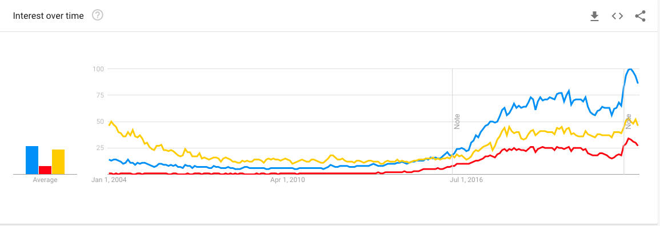

Top 10 Digital Transformation Trends
5G
A faster WiFi
Analytics
AI and Machine Learning
Blockchain
RPA
Conversational AI
Connected vehicles, autonomous drones and Smart Cities
XaaS, UX/CX, and privacy
https://www.forbes.com/sites/danielnewman/2019/07/14/top-10-digital-transformation-trends-for-2020/#39f7aef076be
Why?

Slide 3

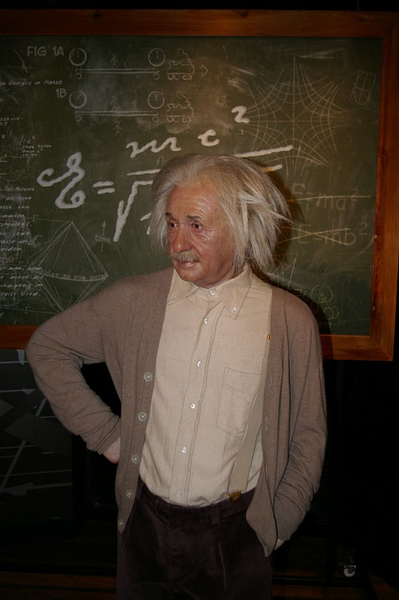




Text
Brain
Vision
Where?
Speech
Image: Google

Slide 4
Procedural
Eg: Tax calculation
Data driven
What?
Memorize
Generalize
Magic
Math!

Slide 5
Examples
Spam vs Non-spam
Forecasting rainfall
Recommending movies
Friend suggestions
Voice/Instrument separation
Grouping pictures in phone
Robot navigation
Stock market prediction
etc …

Slide 6

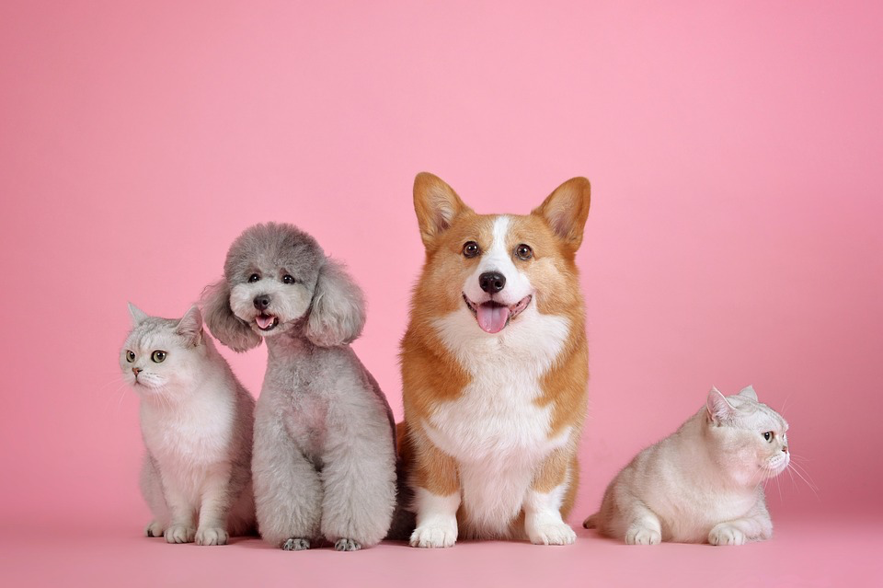

Broad Paradigms
Supervised Learning
Unsupervised Learning
Sequential Learning
Classification
Binary, Multiclass, Ordinal
Regression
Ranking
Structure learning
Clustering
Representation learning
Online learning
Multi-armed Bandits
Reinforcement learning
Image: Google

Slide 7
Examples
Spam vs Non-spam – Binary Classification
Forecasting rainfall - Regression
Recommending movies – Ordinal Classification
Friend suggestions – Link Prediction
Voice/Instrument separation – Unsupervised learning
Grouping pictures in phone - Clustering
Robot navigation – Reinforcement Learning
Stock market prediction – Online learning
etc …

Slide 8
Pre Requisites
Linear Algebra
Probability/Stats
Basic high school calculus

Slide 9
Goals
Obtain a clear understanding of various paradigms of machine learning
Given a real world problem, develop ability to pose it as a relevant machine learning problem.
Understand key ML algorithms and their differences and similarities, pros and cons.
Learn the theoretical/statistical underpinnings of ML and how it relates to practice.
Appreciate the mathematics involved in the algorithms.
Implement ML algorithms from scratch and demonstrate the relevant output of interest using graphs and plots.

Slide 10

A Simple Example
200
Height
(in cms)
100
30
Weight
(in Kgs)
150

Slide 11
A Simple Example
200
STRUCTURE
Height
(in cms)
UNCERTAINITY
DECISION
100
30
Weight
(in Kgs)
150

Slide 12
Foundations
STRUCTURE
Linear Algebra
UNCERTAINITY
Probability
DECISION
Optimization

Slide 13



Tentative Roadmap
Unsupervised Learning
Representation Learning
Unsupervised Learning
Clustering
Unsupervised Learning
Estimation
Supervised Learning
Basic algorithms
Supervised Learning
Advanced algorithms
Supervised Learning
Advanced Topics
Image: Google

Slide 14


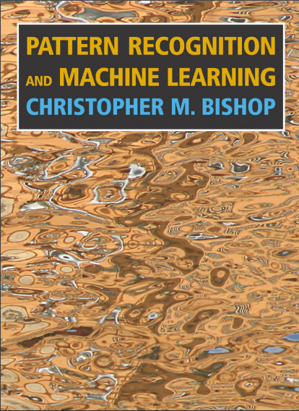
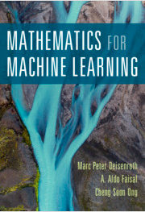
References

Slide 15
Welcome and
All the best!

